Slide 1
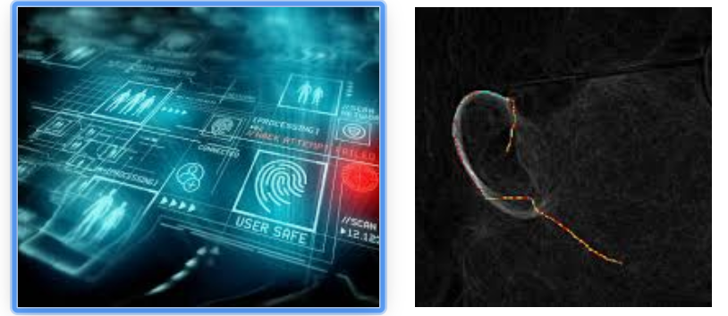
Ear Recognition using Biometrics
Guided By:
Assistant Pro. Priyanka Patel & Assistant Pro. Hemant Yadav
Prepared By:
Jeel Doshi (17IT025)

Slide 2
Out line
Biometrics
Ear Recognition
Identification Vs. Verification
Motivation
Challenges
Basic Idea
Design of Proposed Algorithm
Proposed System
Conclusion & Future Extensions

Slide 3
What is Biometrics?
A biometric system is a pattern recognition system that establishes the authenticity of a specific physiological or behavioral characteristic possessed by a user .
It is regarded as the most secure and accurate authentication tools for verifying human identity With the presence of threats of terrorism and other criminal activity undermining the safety of nations and people.
The need for biometric techniques is apparent.
Thus, the match between a specific biometric and an application is determined depending upon the requirements of the application as well as the properties of individual biometric characteristics.
Examples include fingerprints, iris and retinal scans, hand geometry, signature, voice, DNA, ear and other measures .

Slide 4
Ear

Slide 5
Why Ear Recognition System?
The use of various human features as a tool for personal identification is includes the ear.
As Hurley et al. have observed, ear biometrics as a significant field of research has received inadequate attention in the scientific community, especially in comparison to the more popular methods of utilizing face, eye, or fingerprint in recognition and identification purposes.
Nonetheless, ears played a noteworthy role in forensic science for decades, principally in the United States, where Iannarelli (1989) developed an ear classification system based on manual measurements, which has been in use for many years.
The ear had particular advantages over the more traditional areas used in biometrics, specifically in as much as it has a rich and stable structure that does not change significantly as an individual ages .
Moreover, whilst the face changes radically based on expression, that problem does not exist with ears.
In addition, the immediate background of the ear is very predictable (since it is always located on the side of the head), whereas facial recognition typically requires a controlled background for accurate capture a situation that is obviously not always present. Unlike iris, retina, or fingerprint capture (which are contact biometrics), the ear does not require close proximity to achieve capture.

Slide 6
Identification Vs. Verification
Identification 1:N
Database
Biometrics
Reader
Biometrics
Matcher
Verification 1:1
ID
Biometrics
Reader
Biometrics
Matcher
Database
Match

Slide 7
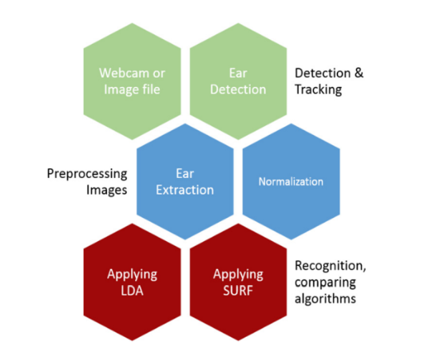
Basic Idea
Flow Chart of the System

Slide 8
Ear detection
Ear feature extraction
Ear Matching

Slide 9
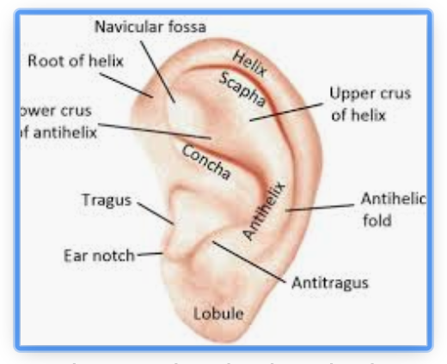
Challenges in ear detection
Illumination Change
Pose Variation
Age Variation
Expression
Occlusion etc…

Slide 10
Motivation
Verify
Age 18
Age 23
Match found

Slide 11
Basic Steps in Ear Recognition

Slide 12
Algorithm
Step-1: Image Acquisition
From Dataset [high resolution image]
From Web camera
Video
Step-2: extracting brightness component through color space transform
Step-3: Localize the Ear
Step-4: Resize the Localize area
Step-5: Convert into binary using threshold function
Step-6: Detect Edges.
Step-7: Extract feature of each edges
Step-8: Aggregate feature data in to dataset
Step-9: Aggregated features will be used as an input to Neural Network
Step-10: Activate each neurons
Step-11: Repeat this until the output layer is reached.
Step-12: Compare the calculated output pattern to the desired target pattern and compute a error value.
Step-13: Change all weights values of each weight using the formula
Weight (old) + Learning Rate * Output Error * Output (Neuron i) * Output (Neuron i + 1) * (1 – Output (Neuron i + 1))
Step-14: Go to the first step.
Step-15: The algorithm end, if all output pattern
Step-16: Match their target pattern.

Slide 13
Test
Image
Gray Scaling
Ear Localize
Resize
Convert in
Binary
Edge Detection
Train Dataset
Ear Localization
Match Image
Both Person Are Same
Yes
Match >= Threshold?
No
Both Person Are Different

Slide 14
1.Detection and Pre-Processing
Modesto Castellon-Santana have developed a hare-cascade classifier to be used with OpenCV to detect left and right ears.
The haar classifier is used to identify the face profiles, with this captures we proceed to obtain the ear using the same haar approach, if this technique cannot identify the ear, the system will compute the IRT.
where the system computes the IRT, then it applies the Gaussian Smoothing in order to reduce noise and remove gaps in the helix. Then the image is thresholded to remove as much of the image as possible whilst trying to leave the helix intact before to use an elliptical template to match the image.
With the ear identified we proceed to perform the pre-processing task, converting the image to gray scale and we begin the normalization process, first we perform the segmentation of the image applying a mask to extract only the ear, then the image is converted to an edge map using the canny edge filter. If w is the width of the image in pixel and h is the height of the image in pixel, the canny edge detector takes as input an array w × h of gray values and sigma.

Slide 15
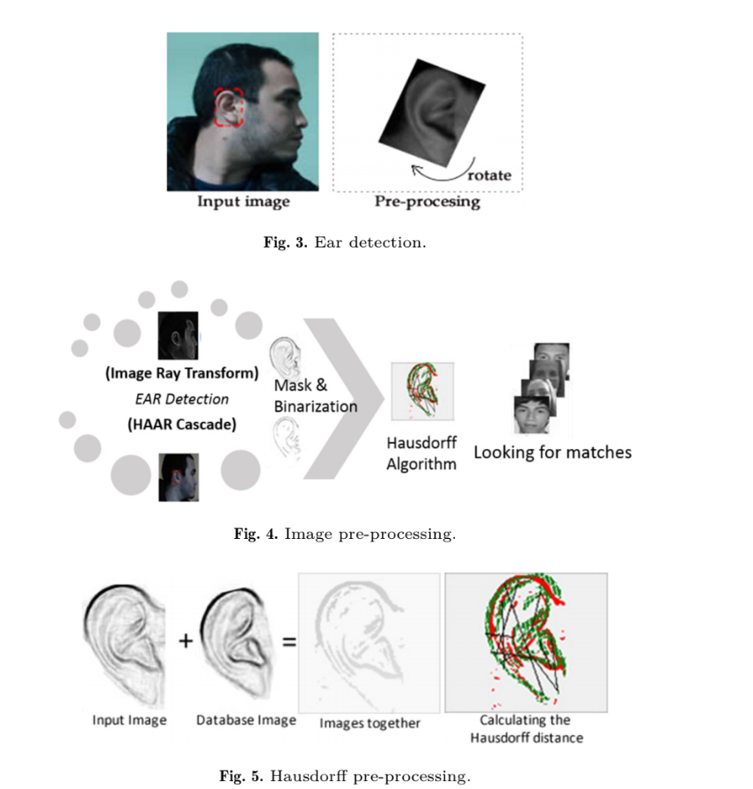
Step 1

Slide 16
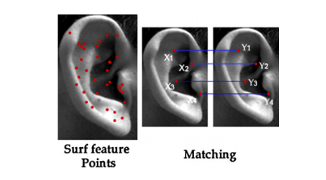
2.Application of Hausdorff Distance
The Hausdorff distance measure used in this document is based on the assumption that the ear regions have different degrees of importance where characteristics such as helix, antihelix, tragus, antitragus, concha, lobe and ear contour play the most important role in ear recognition.
In applying the Hausdorff distance, basically operates the comparison of edge maps.

Slide 17
3.Tracking The Ear
SURF has been designed for extracting highly distinctive and invariant feature points from images.
One of the basic reasons to use SURF for the feature representation is to analyse how the distinctive characteristics works in images, and at the same time is to found more robust with respect to change, taking into account the point of view rotation, scale, illumination and occlusion as compared to other scale and rotation invariant shape descriptors such as SIFT and GLOH .
SURF denotes a picture by first detecting some exclusive feature points in it and then by describing them with the support of a unidirectional feature descriptor.

Slide 18
4. Features Extraction And Recognition
The feature extraction algorithms and the parameter settings that the neural networks require to compute the ear recognition.
Principle Component Analysis (PCM)
Linear Discriminant Analysis (LDA)
SURF algorithm

Slide 19
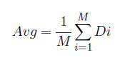
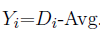
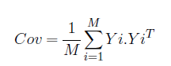
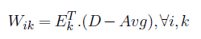
PCA
PCA is to reduce the large dimensionality .
How PCA works?

Slide 20
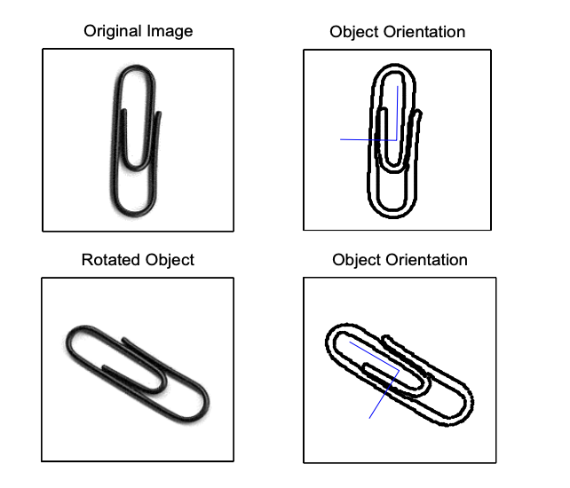
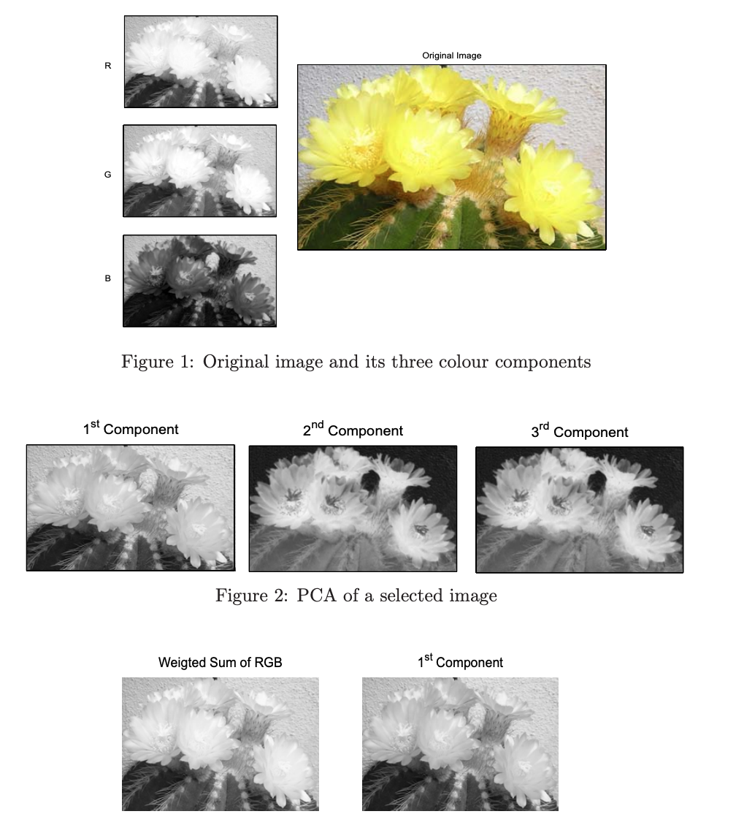

Slide 21
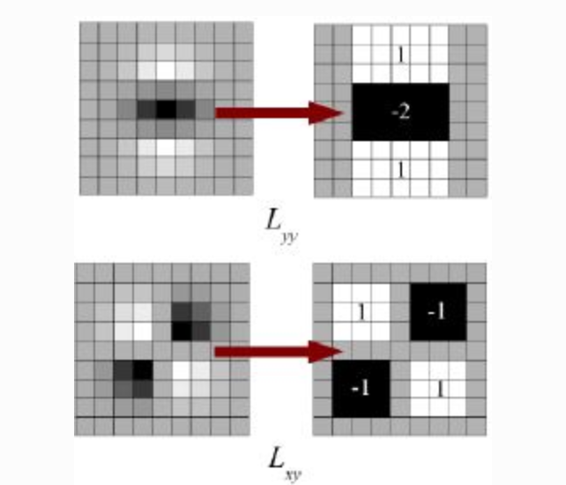
SURF
SURF (Speeded Up Robust Features) As name suggests, it is a speeded-up version of SIFT.
SURF goes a little further and approximates LoG with Box Filter. Below image shows a demonstration of such an approximation. One big advantage of this approximation is that, convolution with box filter can be easily calculated with the help of integral images. And it can be done in parallel for different scales. Also the SURF rely on determinant of Hessian matrix for both scale and location.

Slide 22

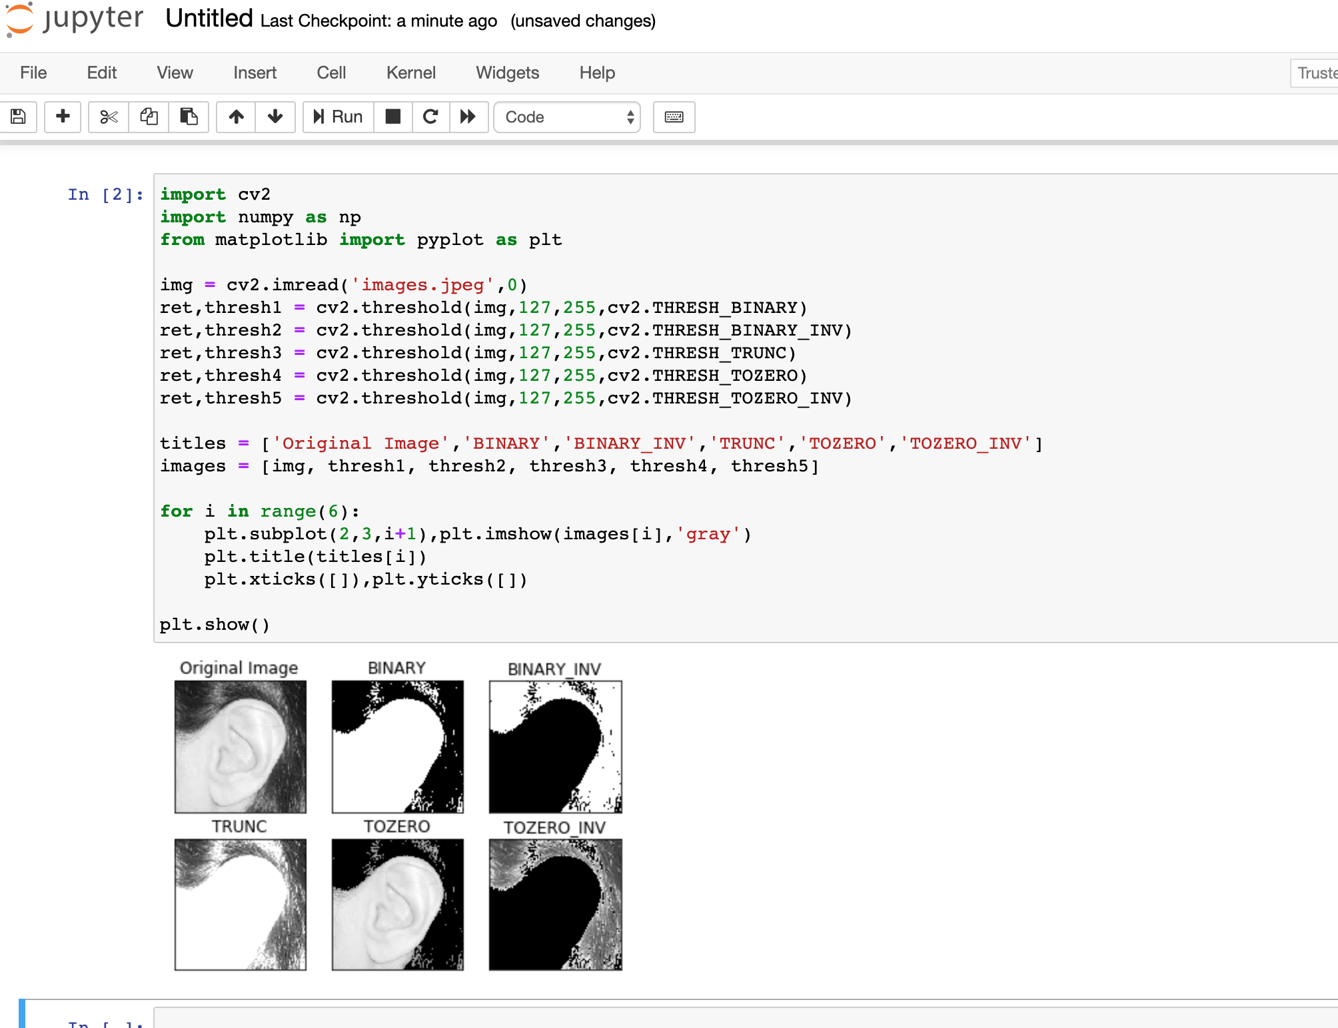
Proposed System
I am going to use Jupyter Notebook for implementation.

Slide 23
Conclusion & Future Extension
The main result of this Analysis is the integration of two algorithms in the ear recognition system. The method used in this research is to try to formulate some of the most common approaches in the process of recognition, the project is not presented as unique and exceptional, But on the methods suggested by other researchers, integrating and comparing them, and attempting to select a combination of these approaches to successfully implement a fully functional device capable of recognizing an individual through his or her ear.
The first technique is based on preprocessing with SURF followed by a classifier based on Feed Forward Neural Network (SURF-NN), and the second is based on preprocessing with LDA (LDA-NN). In both architectures, the feature projection vectors obtained via the SURF and LDA techniques are used as input values in the training and testing stages.
SURF-NN's identification performance among the proposed system is higher than the LDA-NN's. The Neural network which uses SURF Descriptors as input appears to be better than lighting variation. Changes in preprocessing processes allow for better results, especially by using Hausdorff Distance as a filter level. Results have shown that with a simple 3-layer feed-forward neural network with back-propagation training, approximately 95.03 per cent of ear recognition accuracy is achieved even if the images contain some noise. Neural networks offer many other traditional classifiers a great alternative. This type of algorithms are powerful tools that can be trained to perform complex tasks and functions in computer vision applications, in pre-processing tasks, extraction features and pattern recognition as well. As future work, the most interesting and useful resource for the police is to achieve the creation of an application that is capable not only of proposing candidates from an ear picture, but also of identifying and recognizing a suspect using an earprint. Although preliminary, the results of this research point to that objective,Recognition based on these earprints shows significant progress towards the final aim.

Slide 24
References
Research paper 1: https://cse.iitk.ac.in/users/umarani/papers/surya/IPTA_2008.pdf
Research paper 2:A small look at the ear recognition process using a hybrid approach (Journal of Applied Logic)
Pdf: https://slideplayer.com/slide/6027950/
https://towardsdatascience.com/ear-biometrics-machine-learning-a-little-further-1839e5d3e322
https://www.mdpi.com/2227-9717/7/7/457/htm

Slide 25
Thank you

